Slide 1
Image Processing Basic
Computer Vision

Slide 2
Contents
What is an Image
Local Operators
Neighborhood Operators

Slide 3
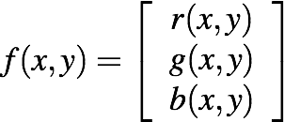
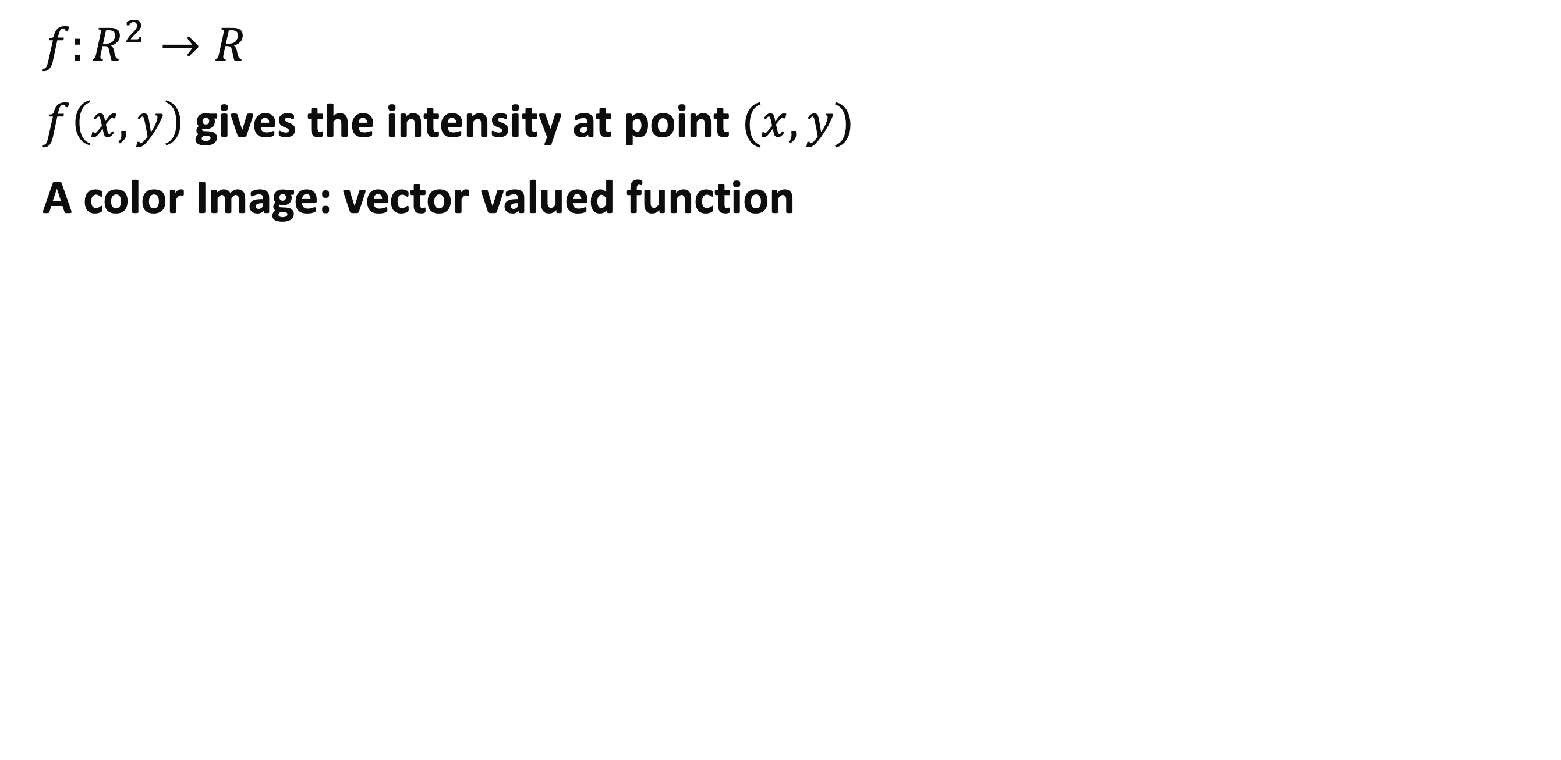
Image as functions
$f:R^{2}→R$
$f\left(x,y\right)$ gives the intensity at point $(x,y)$
A color Image: vector valued function

Slide 4
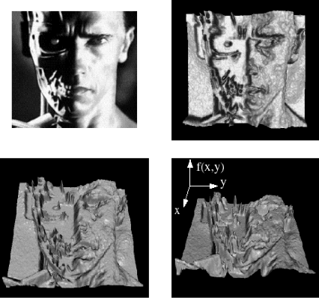

Slide 5
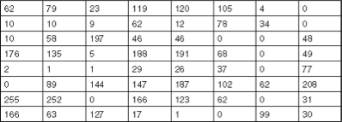
Digital Image
Discrete
sample the 2D space on regular grid
quantize each sample (round to nearest integer)
Matrix form

Slide 6
Image Operations
Local operator
Neighborhood operator

Slide 7
Local Operator

Slide 8
Local Operators
Output pixel value depends on the input pixel value
AKA point process.
ex
brightness and contrast
color correction
transform

Slide 9
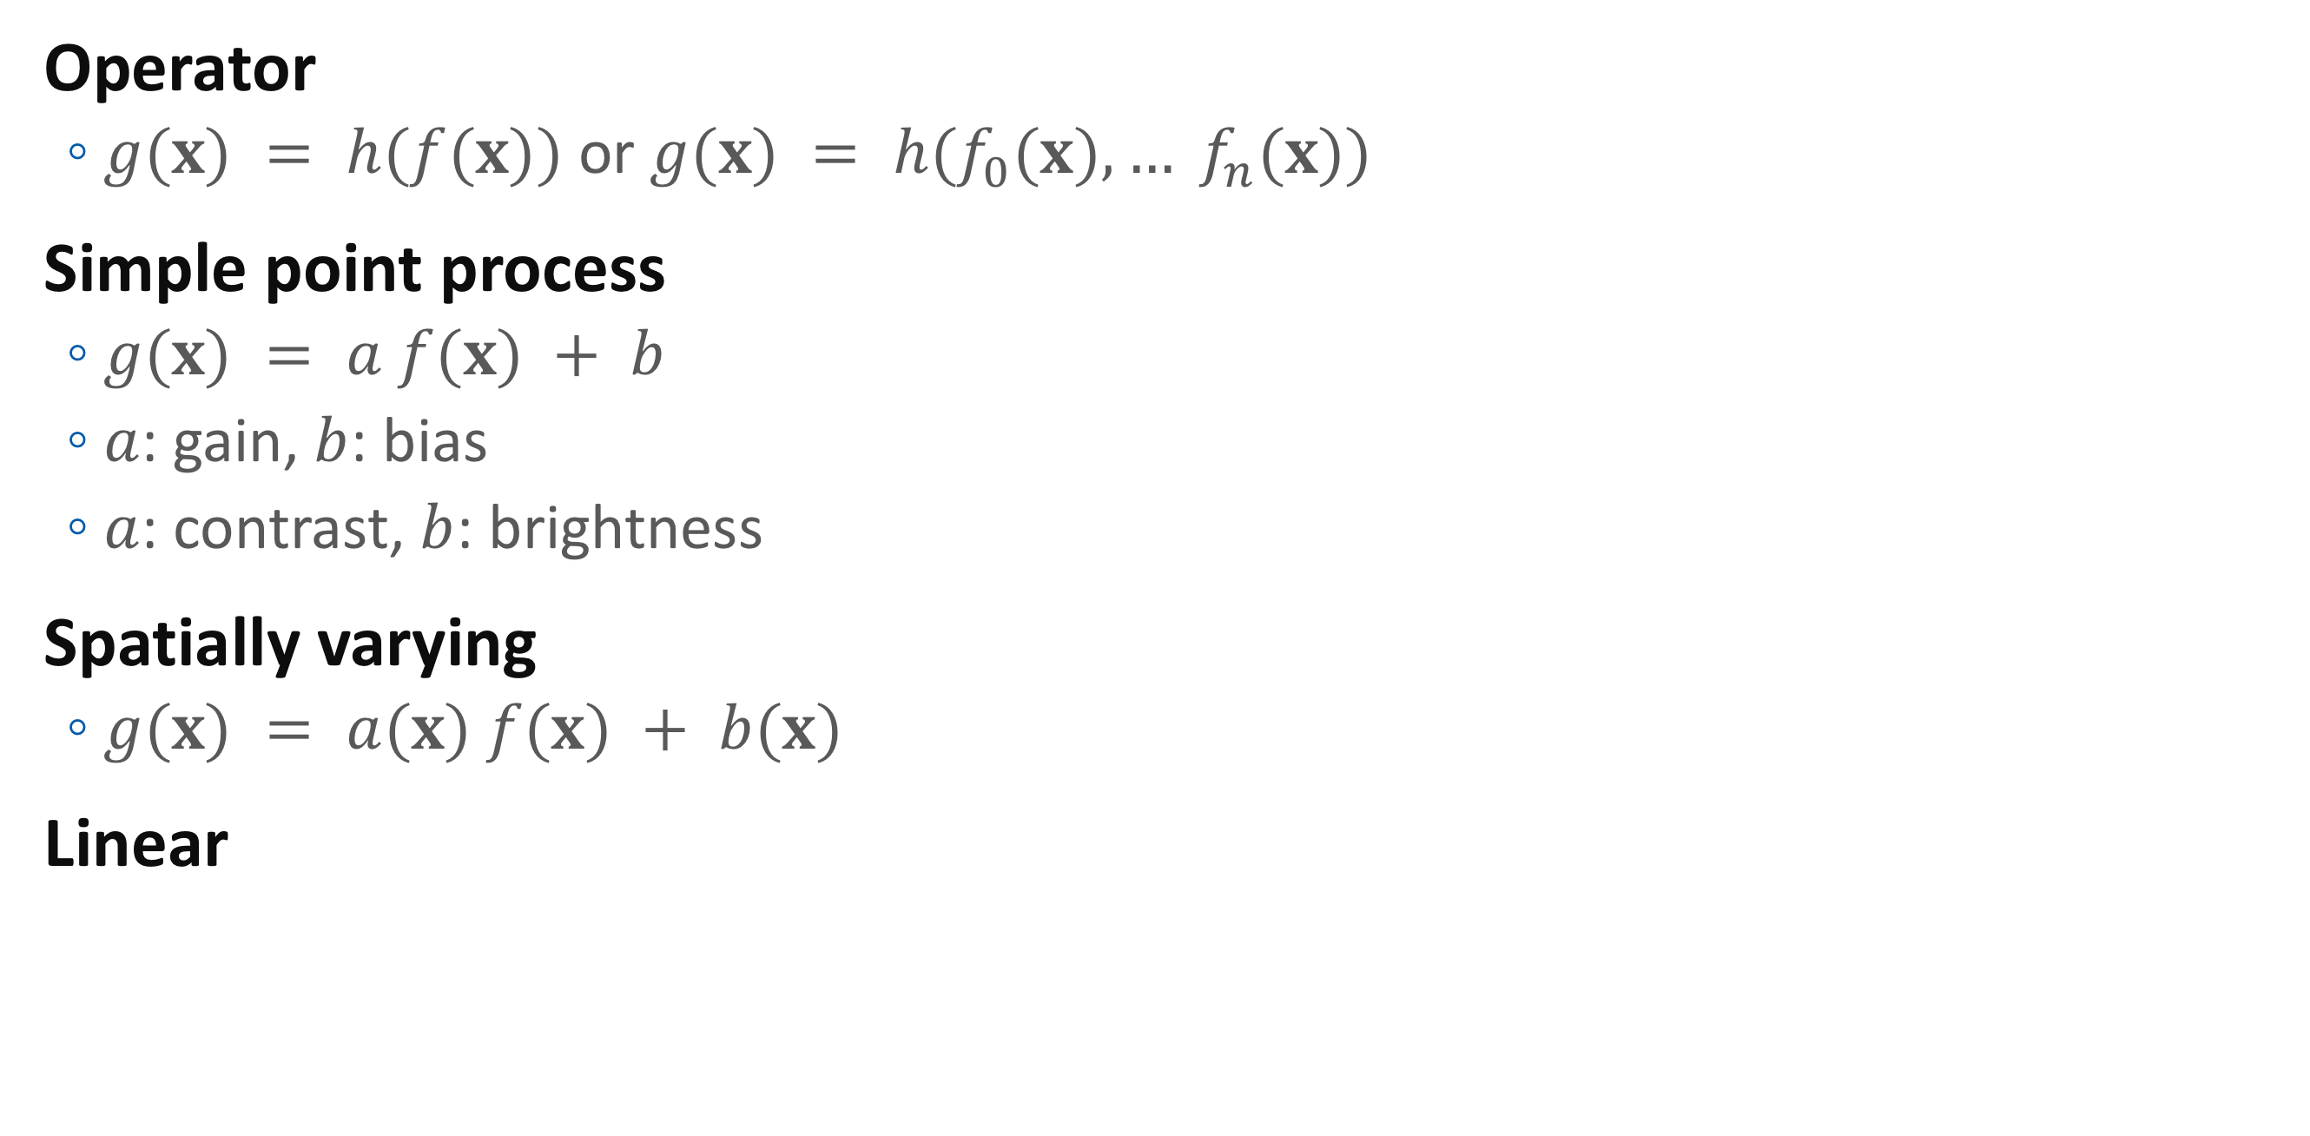
Pixel Transforms
Operator
$g(x) = h(f(x))$ or $g(x) = h(f_{0}(x), … f_{n}(x))$
Simple point process
$g(x) = a f(x) + b$
$a$: gain, $b$: bias
$a$: contrast, $b$: brightness
Spatially varying
$g(x) = a(x) f(x) + b(x)$
Linear

Slide 10
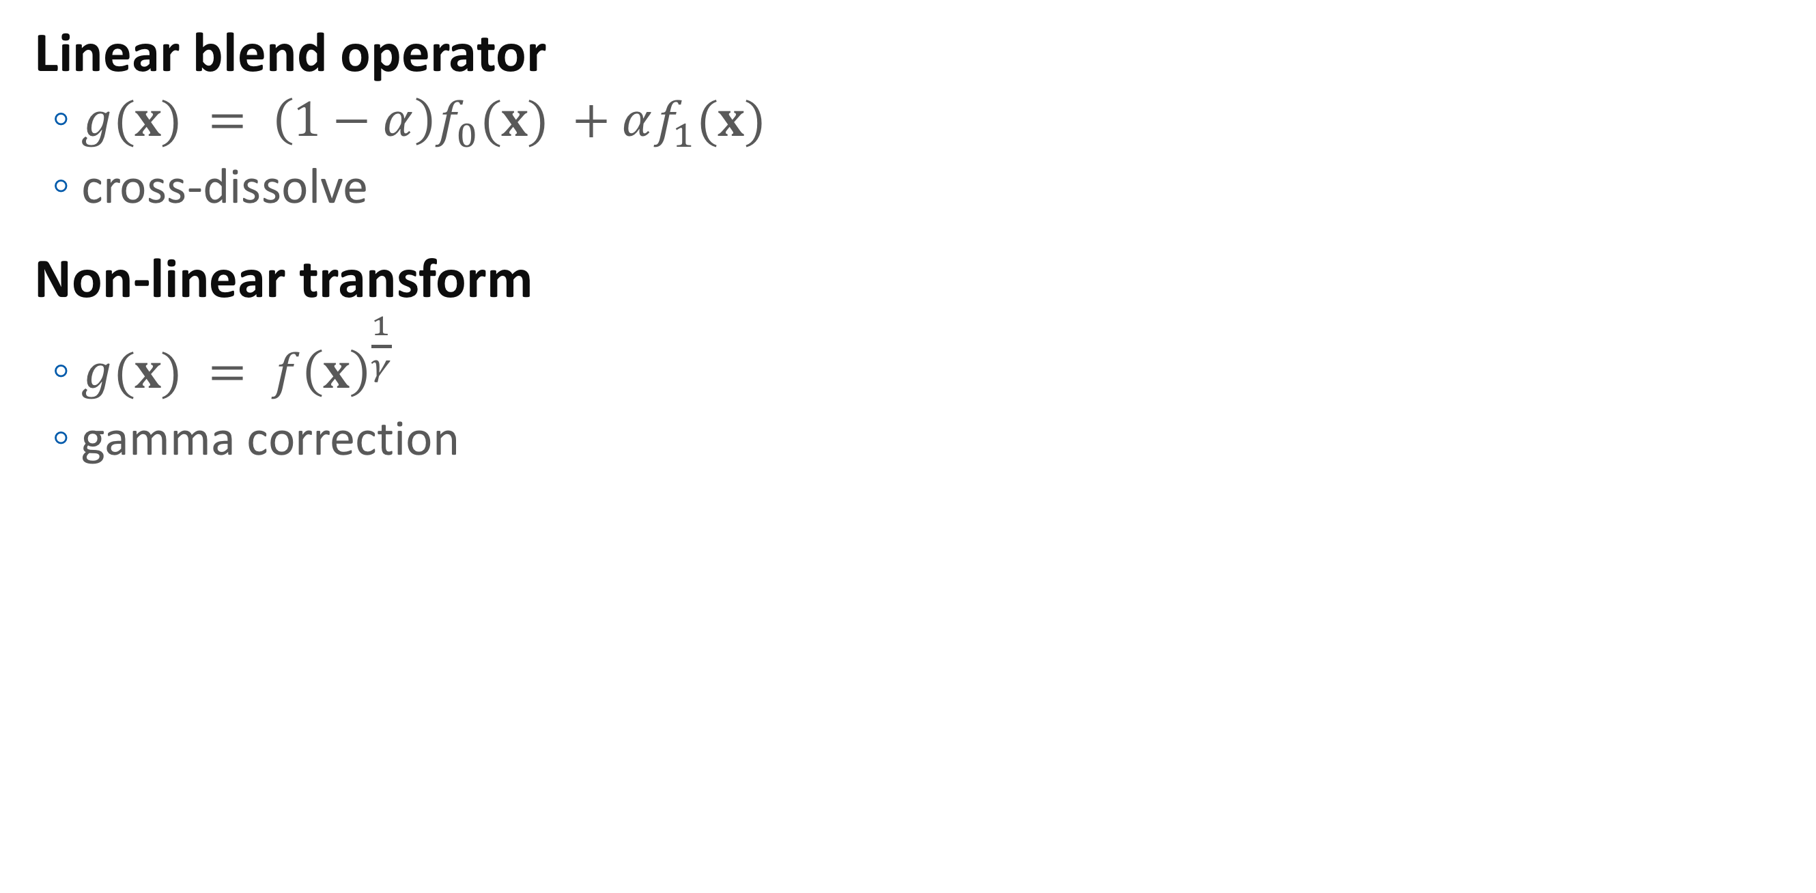
Pixel Transforms
Linear blend operator
$g(x) = \left(1−α\right)f_{0}(x) +αf_{1}(x)$
cross-dissolve
Non-linear transform
$g(x) = f{\left(x\right)}^{\frac{1}{γ}}$
gamma correction

Slide 11
Try in OpenCV
Python
import opencv2 as cv
import matplotlib.pyplot as plt
src = imread("/Users/joony/GoogleDrive/Samsung/2018/bg_0.png")
src32 = np.float32(src)/255
pp = pow( src32, 2.2 )
plt.imshow( cvtColor(np.uint8(pp*255),COLOR_BGR2RGB)); plt.show()
C++
Mat src = imread("/Users/joony/GoogleDrive/Samsung/2018/bg_0.png");
Mat src32 = src.convertTo( CV_32F, 1/255.f );
Mat pp; pow( src32, 2.2, pp );
imshow( “Window”, pp );
waitKey();

Slide 12
Color transforms
Ex: intensity of a color?
Luminance Y
Simple color transform
RGB -> YUV
RGB -> YCrCb
Complex transform
RGB -> XYZ
RGB -> Lab
Later…

Slide 13
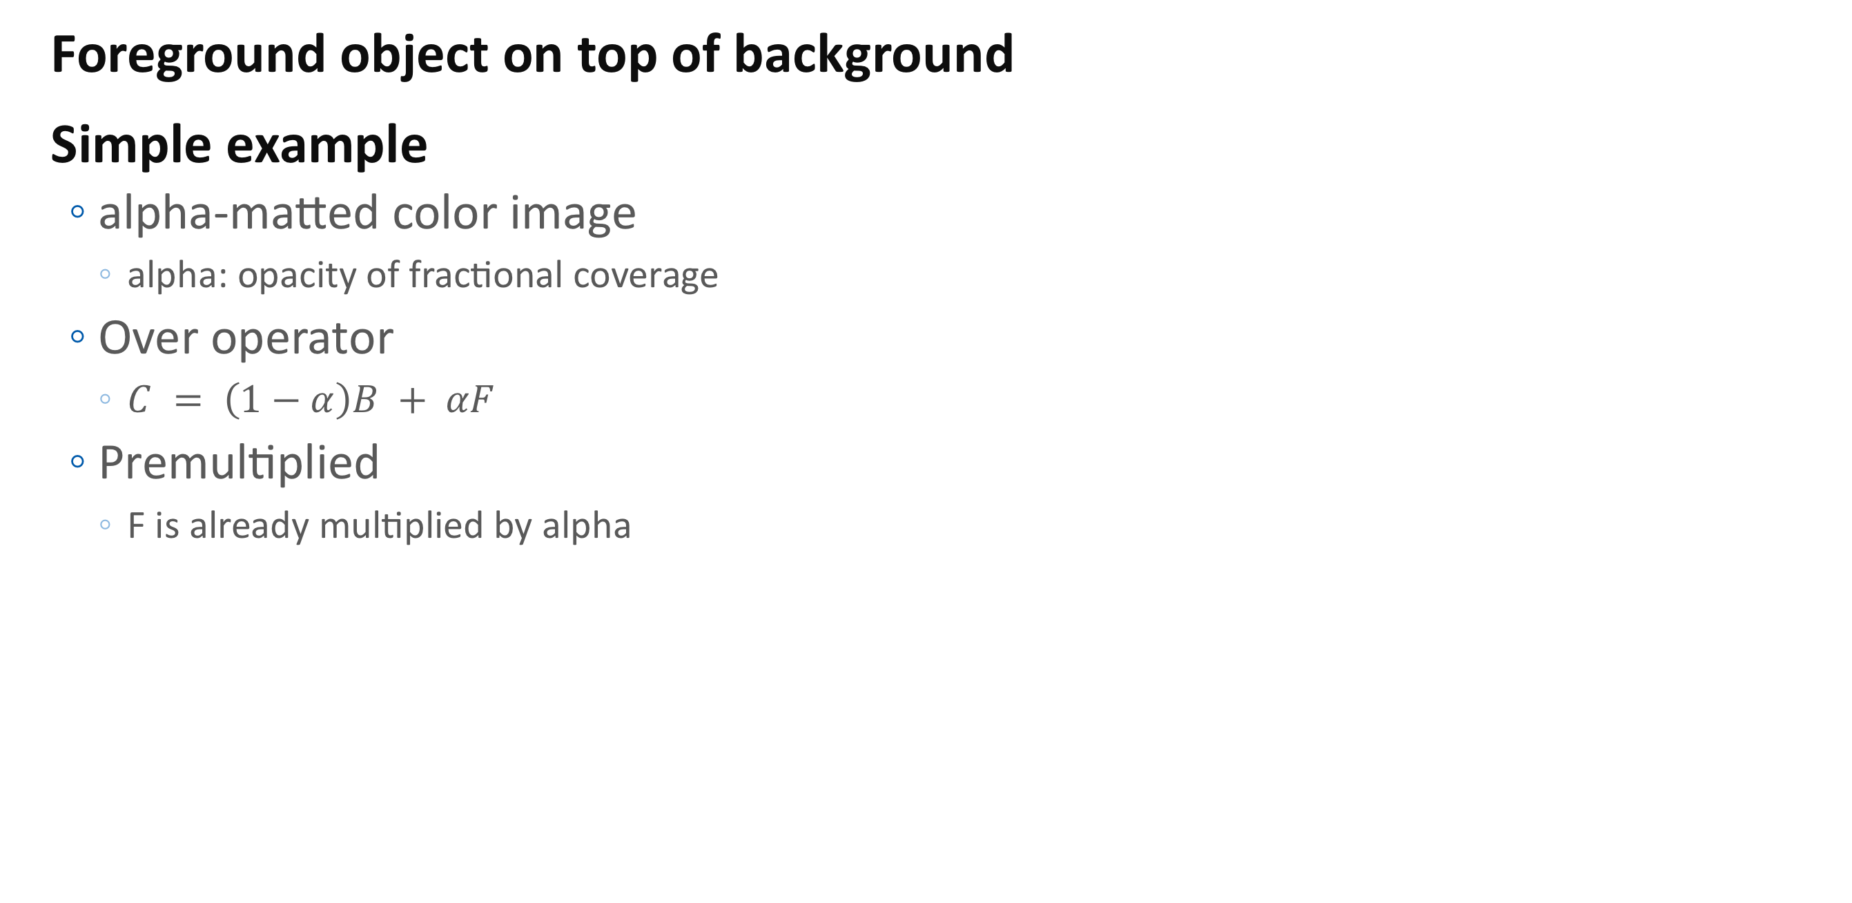
Composition & Matting
Foreground object on top of background
Simple example
alpha-matted color image
alpha: opacity of fractional coverage
Over operator
$C = \left(1−α\right)B + αF$
Premultiplied
F is already multiplied by alpha

Slide 14
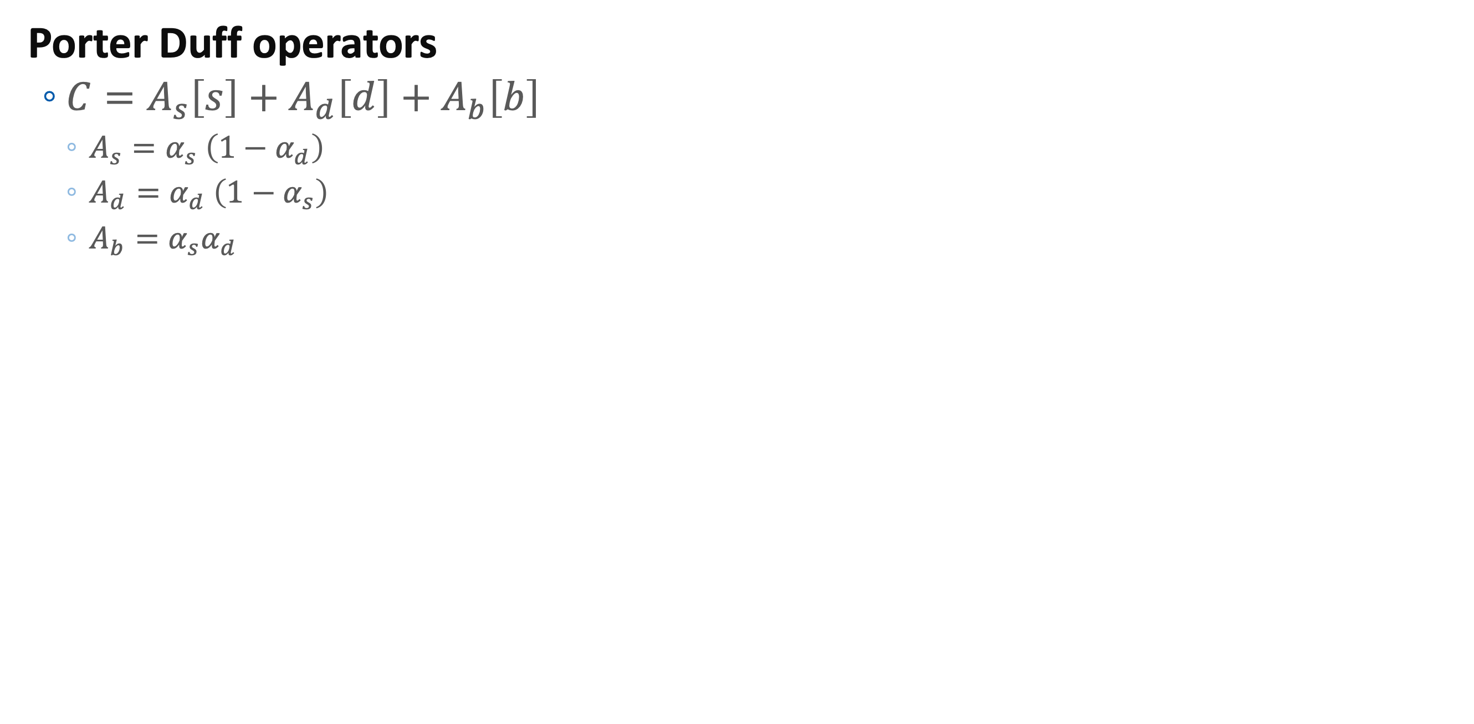
Composition & Matting
Porter Duff operators
$C=A_{s}\left[s\right]+A_{d}\left[d\right]+A_{b}\left[b\right]$
$A_{s}=α_{s} \left(1−α_{d}\right)$
$A_{d}=α_{d} \left(1−α_{s}\right)$
$A_{b}=α_{s}α_{d}$

Slide 15
Composition & Matting
Porter Duff Table
 | [s] | [d] | [b]
Src | s | 0 | s
Atop | 0 | d | s
Over | s | d | s
In | 0 | 0 | s
Out | s | 0 | 0
Dest | 0 | d | d
DestAtop | s | 0 | d
DestOver | s | d | d
DestIn | 0 | 0 | d
DestOut | 0 | d | 0
Clear | 0 | 0 | 0
Xor | s | d | 0

Slide 17
Composition & Matting
Matting
recovering the foreground, background & alpha matte
ex: blue screen matting
extracting the mattes from a single natural image or from extended video sequences is complicated

Slide 18
Linear Neighborhood Operator

Slide 19
Neighborhood Operators
Computing a pixel value based on the corresponding input pixel and its neighbor pixels
ex: local adaptive histogram equalization
Filters
linear & nonlinear neighborhood operators

Slide 20
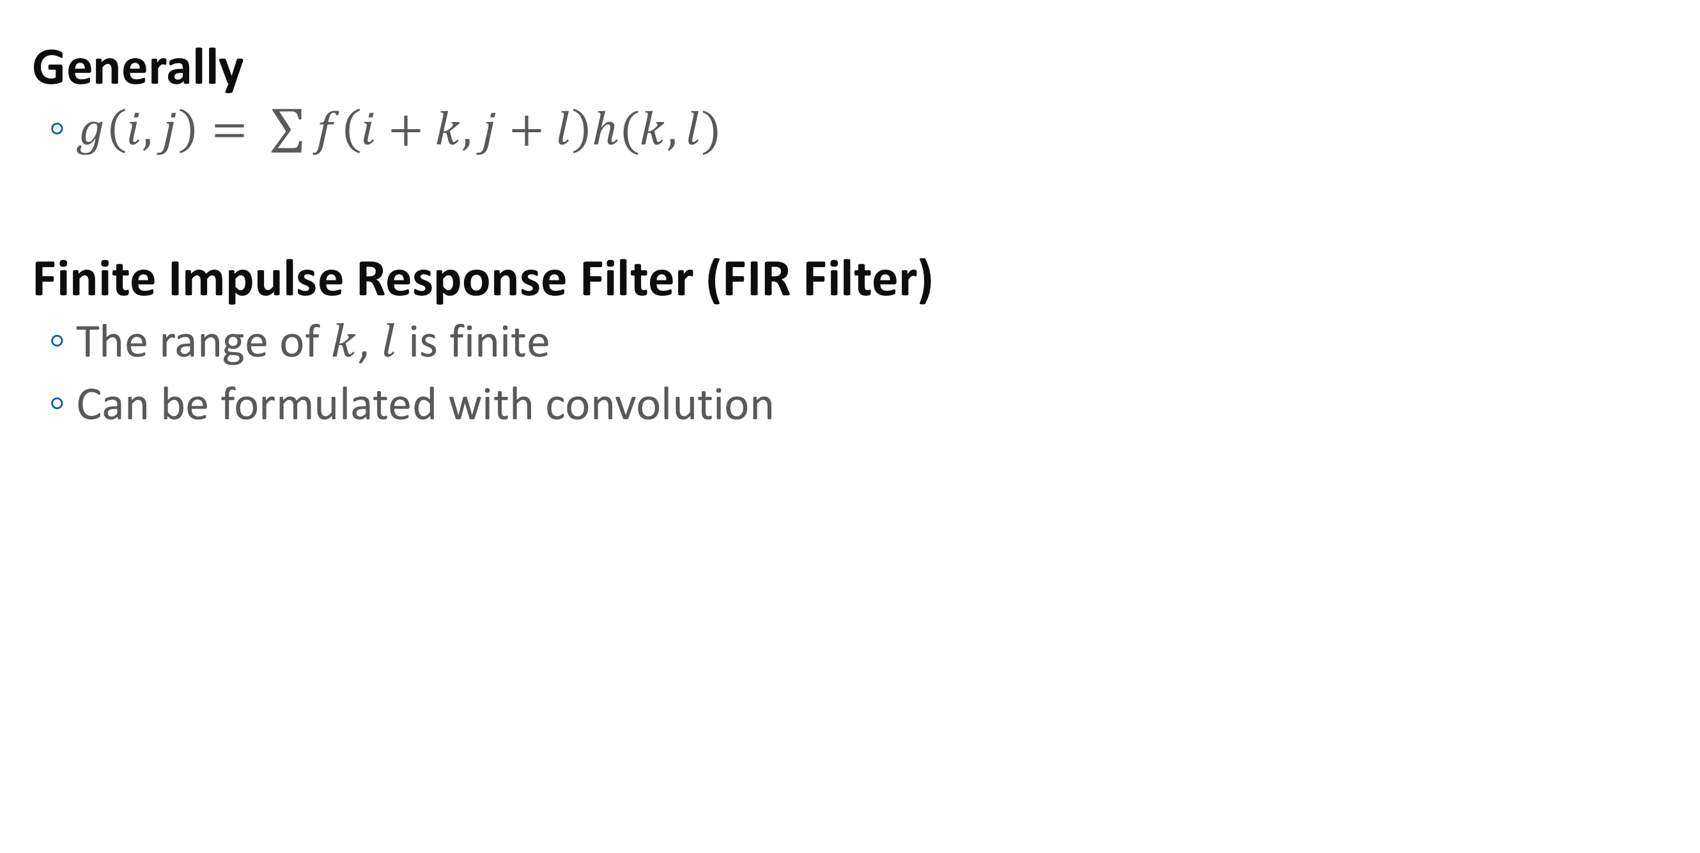
Linear filtering
Generally
$g\left(i,j\right)= \sum{f\left(i+k,j+l\right)h(k,l)}$
Finite Impulse Response Filter (FIR Filter)
The range of $k$, $l$ is finite
Can be formulated with convolution

Slide 21
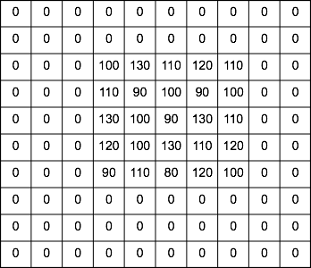
More about FIR Filter
Noise filtering example

Slide 22
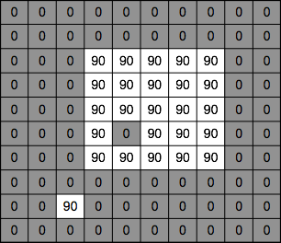
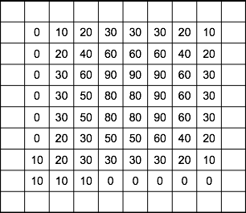


Mean filtering

Slide 23
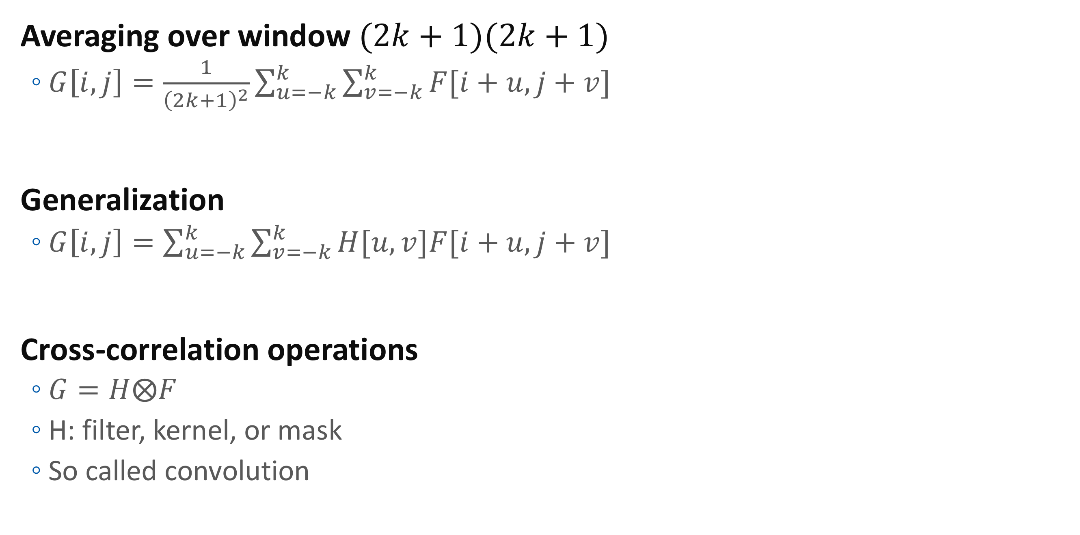
Cross-correlation filtering
Averaging over window $(2k+1)(2k+1)$
$G\left[i,j\right]=\frac{1}{{\left(2k+1\right)}^{2}}\sum_{u=−k}^{k}{\sum_{v=−k}^{k}{F[i+u,j+v]}}$
Generalization
$G\left[i,j\right]=\sum_{u=−k}^{k}{\sum_{v=−k}^{k}{H[u,v]F[i+u,j+v]}}$
Cross-correlation operations
$G=H⨂F$
H: filter, kernel, or mask
So called convolution

Slide 24
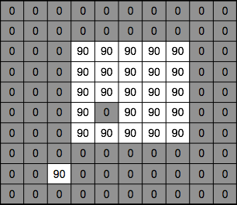
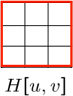

Mean kernel

Slide 25
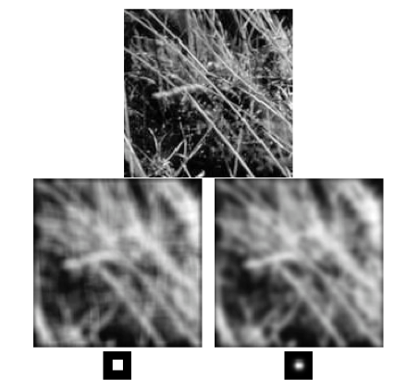
Mean (box) vs Gaussian filtering

Slide 26
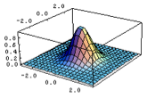
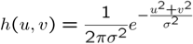
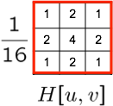
Gaussian filtering
Gaussian kernel
3x3

Slide 27
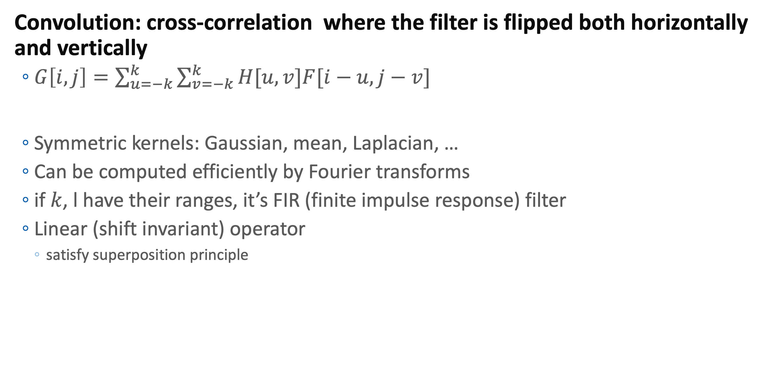
Linear filtering as Convolution
Convolution: cross-correlation where the filter is flipped both horizontally and vertically
$G\left[i,j\right]=\sum_{u=−k}^{k}{\sum_{v=−k}^{k}{H[u,v]F[i−u,j−v]}}$
Symmetric kernels: Gaussian, mean, Laplacian, …
Can be computed efficiently by Fourier transforms
if $k$, l have their ranges, it’s FIR (finite impulse response) filter
Linear (shift invariant) operator
satisfy superposition principle

Slide 28
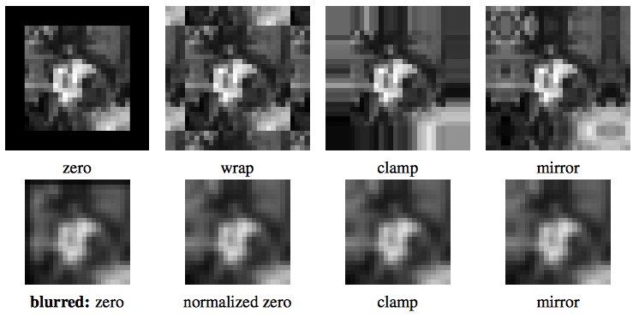
Padding
convolution need same sized images

Slide 29
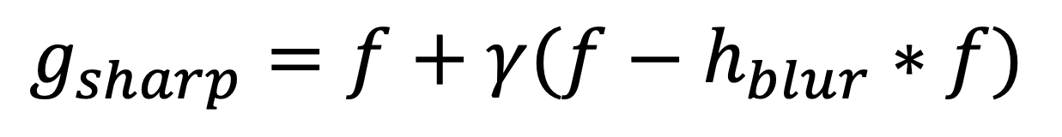
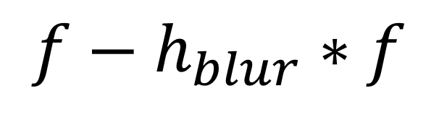
Gaussian application
Low-pass filtering
reducing high-frequency noise
High-pass filter
Sharpening?
$$f−h_{blur}∗f$$
$$g_{sharp}=f+γ(f−h_{blur}∗f)$$

Slide 30
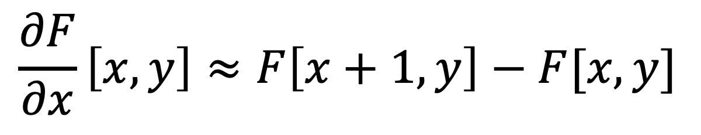
Image gradient
Differentiation of a digital image
discrete derivative (finite difference)
$$\frac{∂F}{∂x}\left[x,y\right]≈F\left[x+1,y\right]−F[x,y]$$

Slide 31
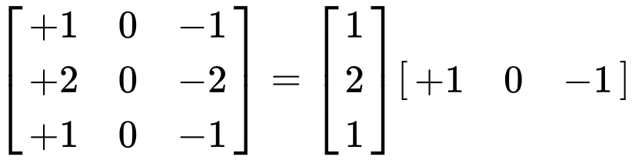
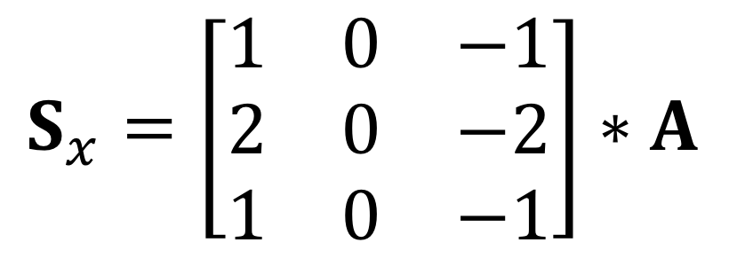
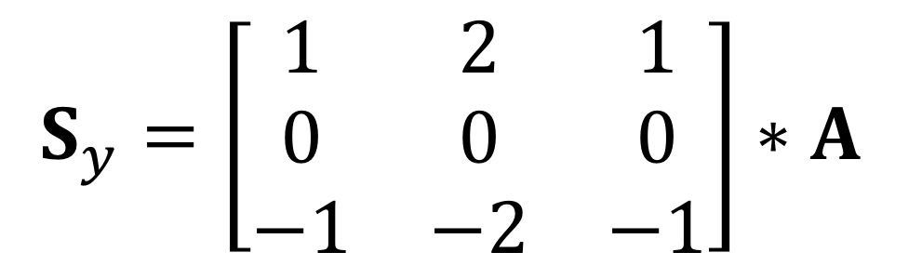
Sobel Filter
Approximation of the Gradient
More stable (less sensitive to noise)
$$S_{x}=\left[\begin{matrix}1 & 0 & −1 \\ 2 & 0 & −2 \\ 1 & 0 & −1\end{matrix}\right]∗A$$
$$S_{y}=\left[\begin{matrix}1 & 2 & 1 \\ 0 & 0 & 0 \\ −1 & −2 & −1\end{matrix}\right]∗A$$

Slide 32
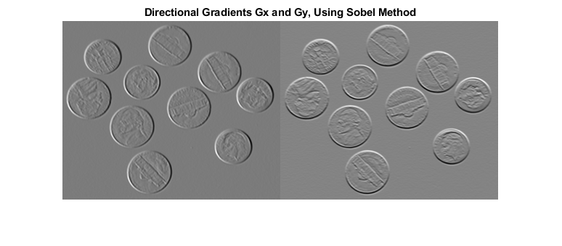
Sobel Filter

Slide 33
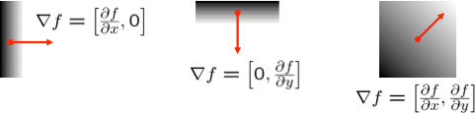
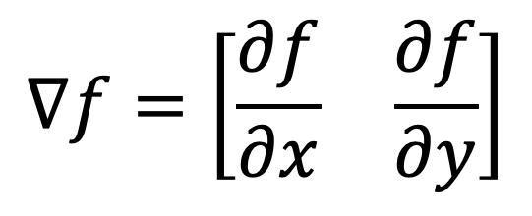
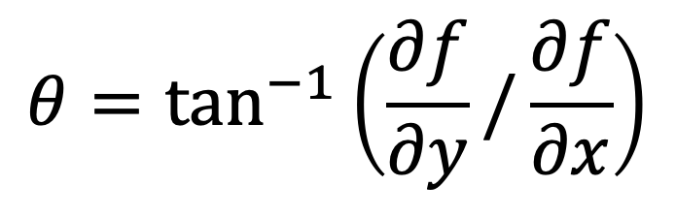
Image gradient
$$∇f=\left[\begin{matrix}\frac{∂f}{∂x} & \frac{∂f}{∂y}\end{matrix}\right]$$
Pointing in the direction of most rapid change in intensity
Gradient direction
$$θ=\tan^{−1}\left(\frac{∂f}{∂y}/\frac{∂f}{∂x}\right)$$

Slide 34
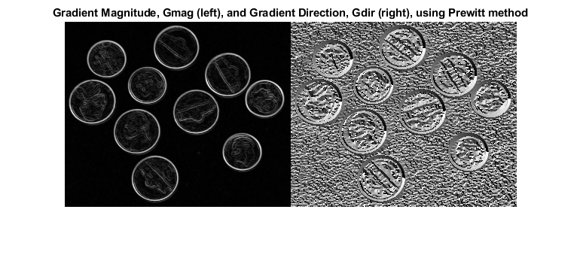

Edge Strength
At edge, the magnitude of gradient is big
The edge strength:
$$\left\|∇f\right\|=\sqrt{{\left(\frac{∂f}{∂x}\right)}^{2}+{\left(\frac{∂f}{∂x}\right)}^{2}}$$

Slide 35
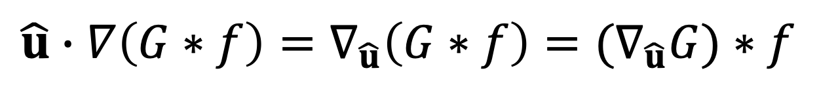
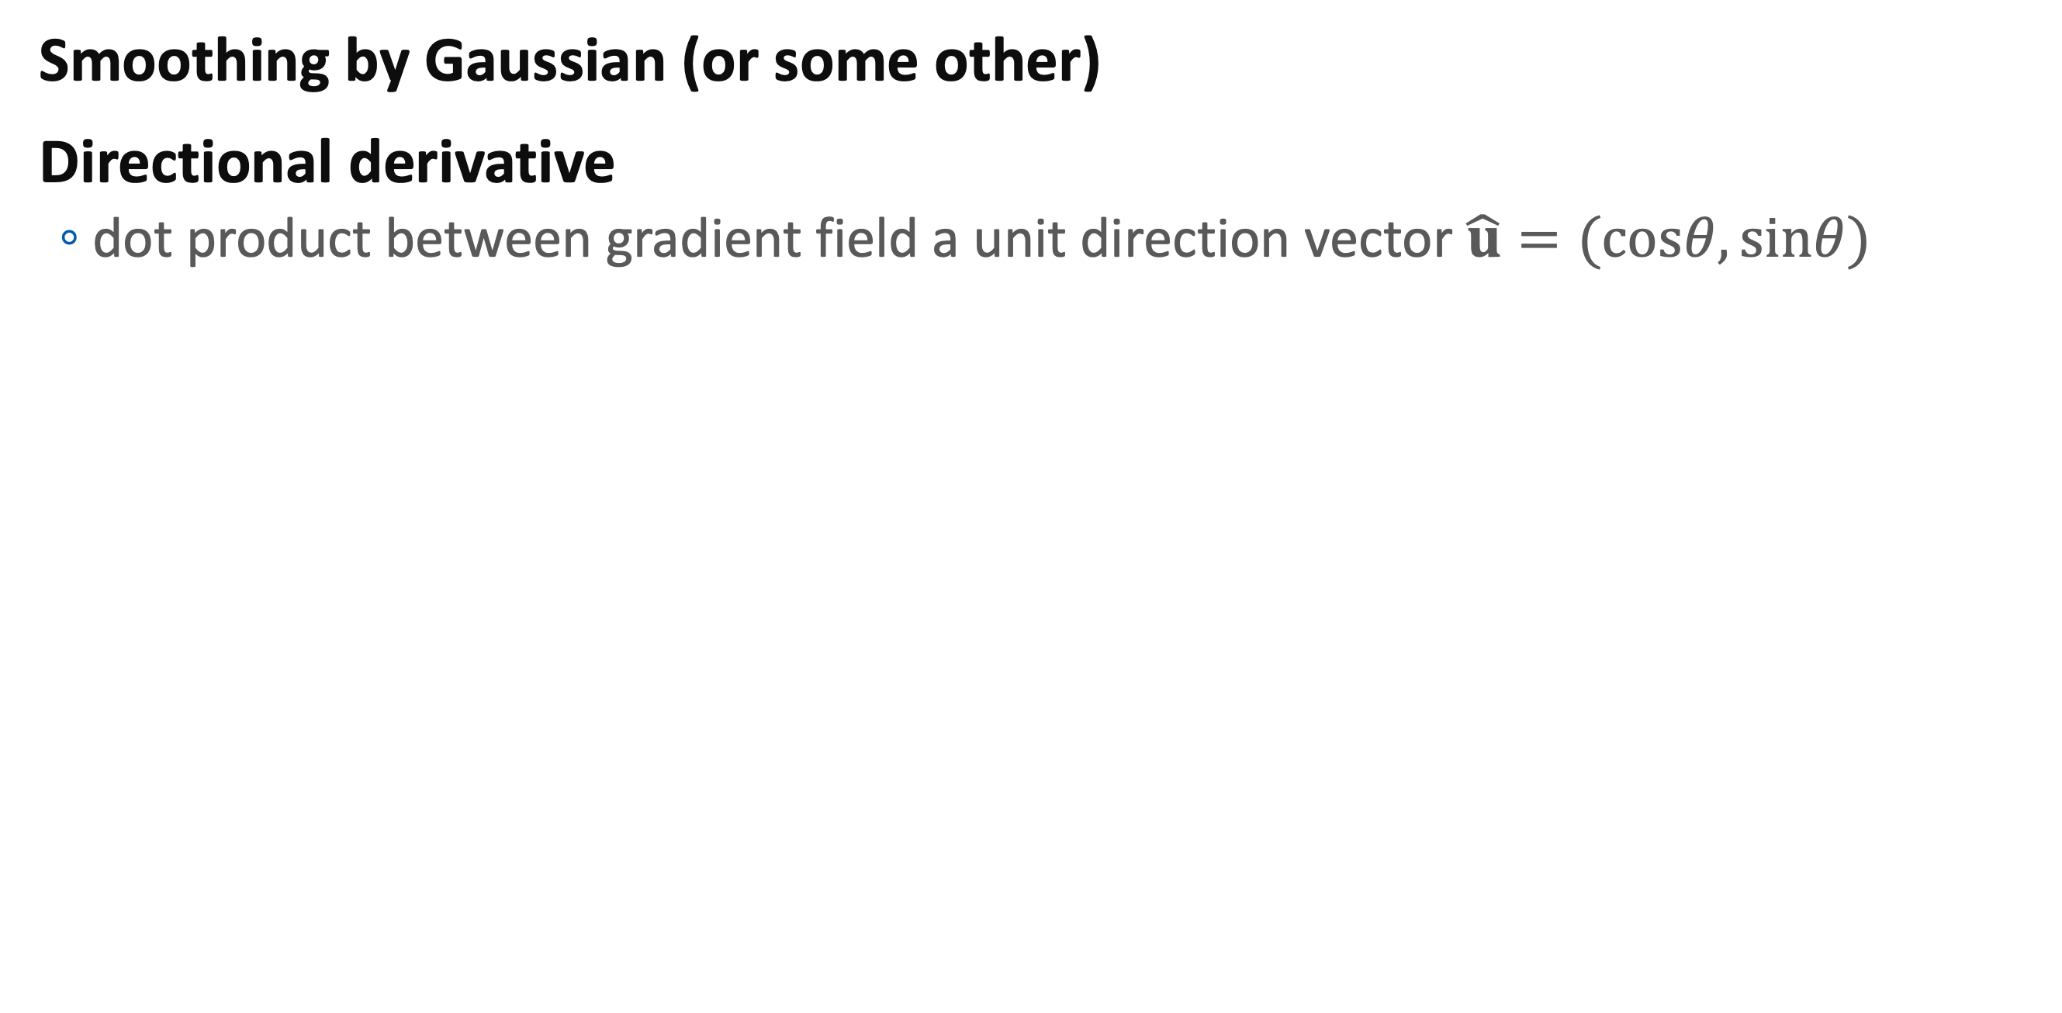
Directional (oriented) filter
Smoothing by Gaussian (or some other)
Directional derivative
dot product between gradient field a unit direction vector $\hat{u}=(cosθ,sinθ)$
$$\hat{u}∙∇\left(G∗f\right)=∇_{\hat{u}}\left(G∗f\right)=(∇_{\hat{u}}G)∗f$$

Slide 36
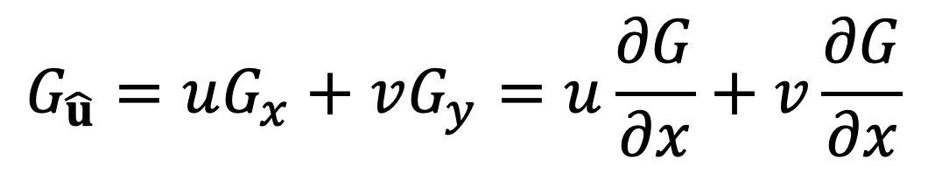
Steerable filter
Convolutional filters which is orientation selective
Ex:
Derivative of Gaussian
which is dot product of derivative of Gaussian
$$G_{\hat{u}}=uG_{x}+vG_{y}=u\frac{∂G}{∂x}+v\frac{∂G}{∂x}$$

Slide 37
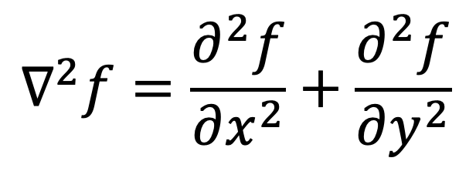
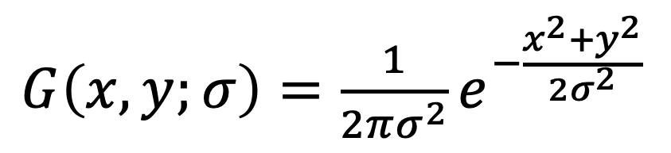

Frequency Filtering
Smoothing (with Gaussian)
(undirected) second derivatives (Laplacian)
=> LoG (Laplacian of Gaussian)
$G\left(x,y;σ\right)=\frac{1}{2πσ^{2}}e^{−\frac{x^{2}+y^{2}}{2σ^{2}}}$
$$∇^{2}f=\frac{∂^{2}f}{∂x^{2}}+\frac{∂^{2}f}{∂y^{2}}$$
$∇^{2}G\left(x,y;σ\right)=\left(\frac{x^{2}+y^{2}}{σ^{4}}−\frac{1}{σ^{2}}\right)$ $G\left(x,y;σ\right)$

Slide 38
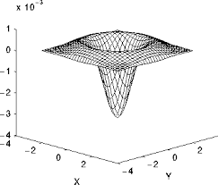
Laplacian of Gaussian

Slide 39
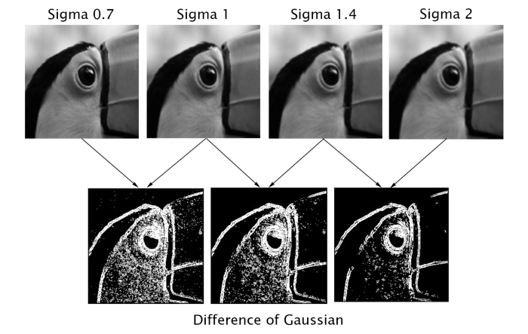
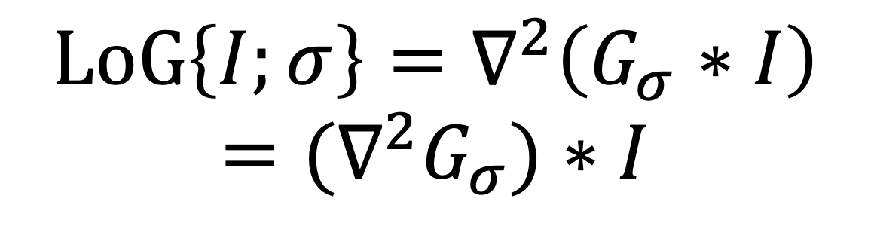

Band-pass Filter
Difference of Gaussian
Laplacian of Gaussian version
$$DoG\left\{I;σ_{1},σ_{2}\right\}=G_{σ_{1}}∗I−G_{σ_{2}}∗I=(G_{σ_{1}}−G_{σ_{2}})∗I$$
$$LoG\left\{I;σ\right\}=∇^{2}\left(G_{σ}∗I\right)=(∇^{2}G_{σ})∗I$$

Slide 40
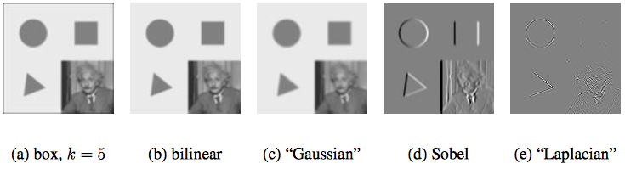
Typical operators
box (moving average, mean)
bilinear (3x3)
Gaussian
Sobel
Laplacian

Slide 41
Image Pyramids
Interpolation
Decimation
Multiresolution representations
Application

Slide 42
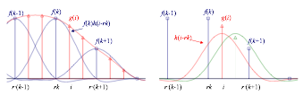
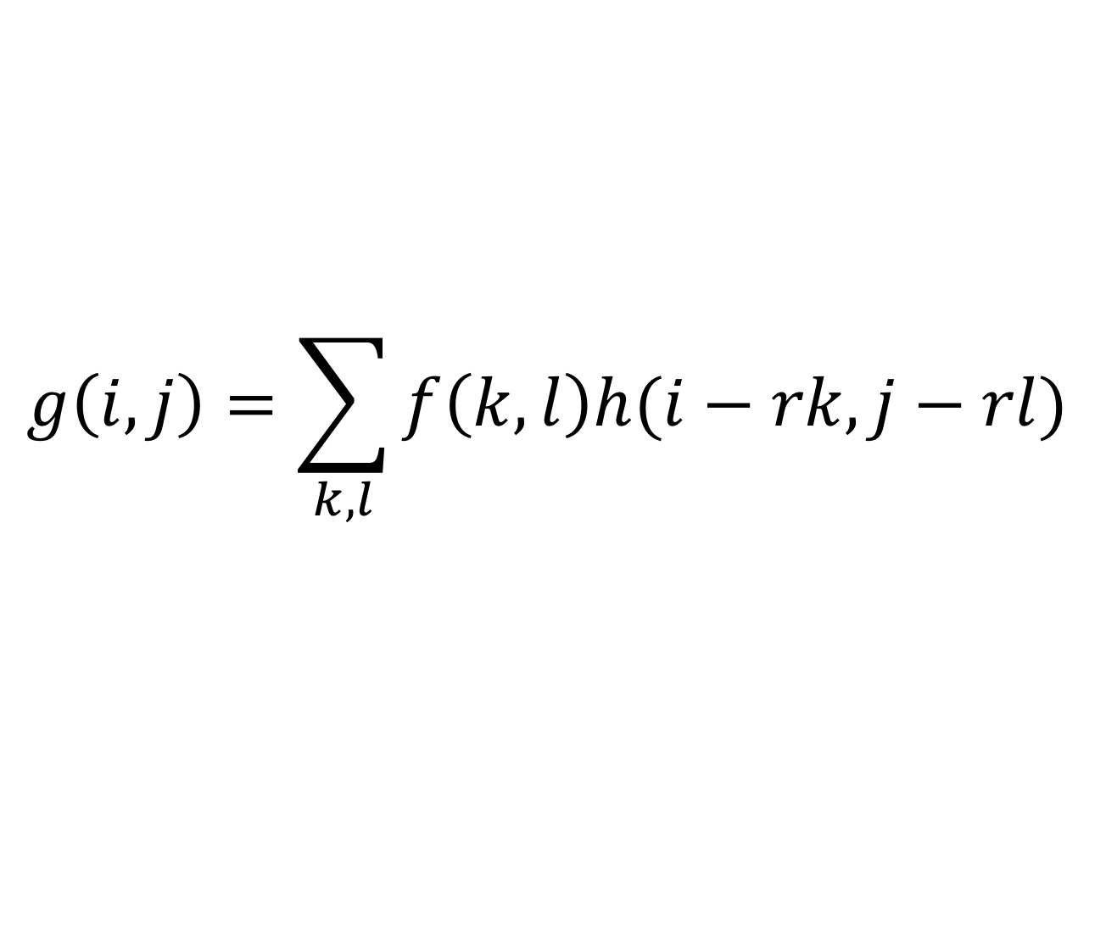
How up-sampling work
Interpolation
which is convolution
h: interpolation kernel
$$g\left(i,j\right)=\sum_{k,l}{f\left(k,l\right)h(i−rk,j−rl)}$$

Slide 43
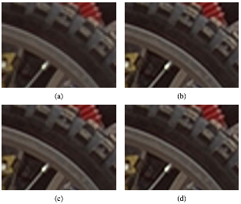
Typical Up-sampling Kernels

Slide 44
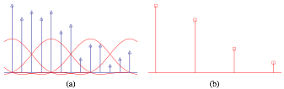
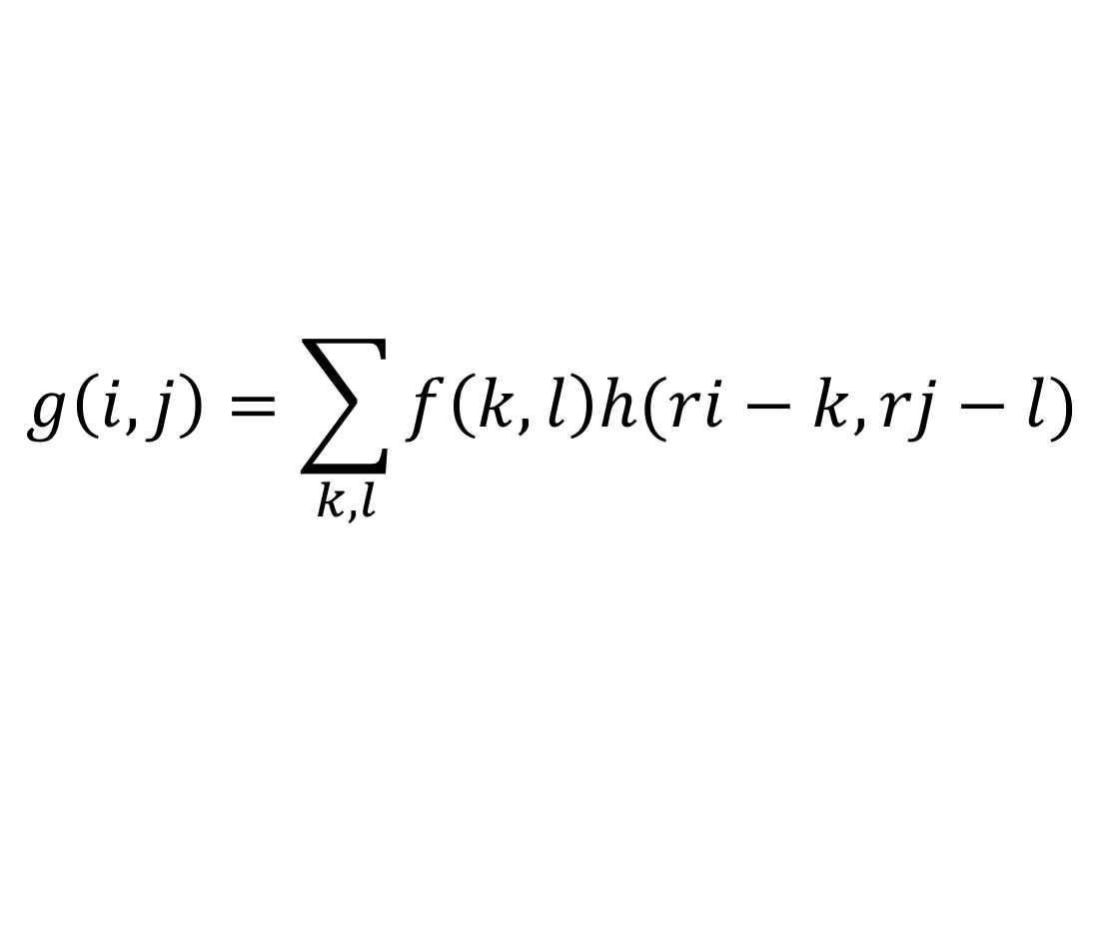
Decimation (Down-sampling)
Low-pass filtering & re-sampling
can use same interpolation kernel
$$g\left(i,j\right)=\sum_{k,l}{f\left(k,l\right)h(ri−k,rj−l)}$$

Slide 45
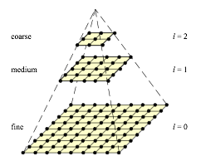
Multi-resolution representation

Slide 46
Applications
Scale-invariant feature detection
same feature from big & small images
feature point at smooth area
coarse to find matching
Multi-band blending
edge preserving smooth interpolation

Slide 47
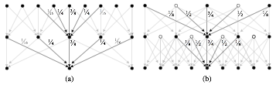
Gaussian Pyramid
Fine to coarse
Gaussian -> down-sampling
Coarse to fine
Adding zero pixels and Gaussian

Slide 48

Laplacian Pyramid

Slide 49






Laplacian Pyramid
Finest octave: high pass
Middle octaves: band pass
Lowest octave: low pass

Slide 50

How to Compute
Band-pass filter version
Difference of Gaussian
$$DoG\left\{I;σ_{1},σ_{2}\right\}=G_{σ_{1}}∗I−G_{σ_{2}}∗I=(G_{σ_{1}}−G_{σ_{2}})∗I$$

Slide 51

In practice
Lowest octave
$L(l) = G(l; f)$
Higher octave
$L(l) = G(l;f) − Upsample(G(l+1;f))$
which is
$Upsample(G(l+1;f))$: Lowpass filtered version of $G(l;f)$
Difference: high frequency

Slide 52

Application: Multi-band blending

Slide 53


Slide 54
Nonlinear Neighborhood Operator

Slide 55

Non-linear Filtering
Non linear combination of neighboring pixels
ex:
Median filtering
choose block median
a-trimmed mean
average of neighbors excluding boundaries
weighted median
$$\sum_{k,l}{w\left(k,l\right){\left|f\left(i+k,j+l\right)−g\left(i,j\right)\right|}^{p}}$$

Slide 56


Nonlinear filtering
Bilateral filtering
Edge preserving filter
$$g\left(i,j\right)=\frac{\sum_{k,l}{f(k,l)w(i,j,k,l)}}{\sum_{k,l}{w(i,j,k,l)}}$$
$$w\left(i,j,k,l\right)=\exp\left(−\frac{{\left(i−k\right)}^{2}+{\left(j−l\right)}^{2}}{2σ_{d}^{2}}−\frac{{\left\|f\left(i,j\right)−f\left(k,l\right)\right\|}^{2}}{2σ_{r}^{2}}\right)$$

Slide 57

Bilateral Filter Kernel

Slide 58

Morphology
Originally for binary image
where c is # of 1 pixels in range (usually 3x3)
S is # of pixels in range
dilation: c>0
erosion: c>=S
majority: c>S/2
opening: dilate(erode())
closing: erode(dilate())

Slide 59

Distance transforms & Connected Comp.
Distance transforms
distance can be Manhattan or Euclidean
Connected component transform
connected components: regions of adjacent pixels with same input value

Slide 60


Histogram Equalization
Finding an intensity mapping function f(I)
the resulting histogram is flat
$h(I)$ is histogram of intensity
Partial compensation
$f\left(I\right)= αc(I) + (1−α)I$

Slide 61

Histogram Equalization
Local adaptive histogram equalization
recompute $M×M$ block centered at each pixel
efficient method
non-overlapped block-based equalization
interpolate the transfer function between blocks

Slide 62


Histogram Equalization
Fixing low contrast image
Histogram

Slide 63
Histogram Equalization
Making histogram flatter
Output pixel intensity is determined by the intensity distribution
Count all darker pixels
Choose output pixel intensity based on the number of the darker pixels

Slide 64

Histogram Equalization
Finding an intensity mapping function $c(I)$
the resulting histogram is flat
$c\left(I\right)=\frac{1}{N}\sum_{i=0}^{I}{h(i)}=c\left(I−1\right)+\frac{1}{N}h(I)$
$h(I)$ is histogram of intensity
Partial compensation
$f(I) = αc(I) + (1−α)I$

Slide 65

Histogram Equalization
Local adaptive histogram equalization
recompute $M×M$ block centered at each pixel
efficient method
non-overlapped block-based equalization
interpolate the transfer function between blocks
Contrast-limited local adaptive histogram equalization
Limited contrast amplification

